Slide 1
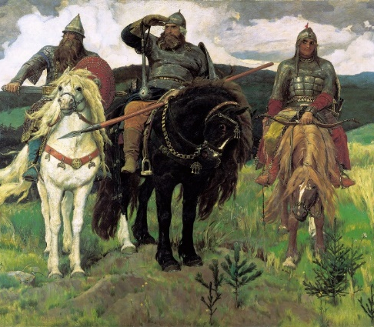
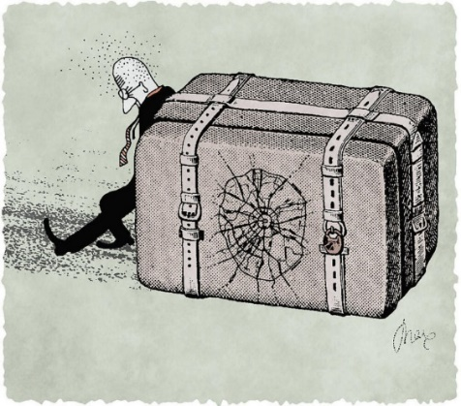
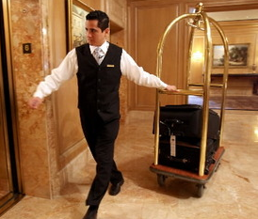
2020

Slide 2
Some words about 2020
The year 2020 will be something to remember for everyone.
It has changed so many things.
As smart people say: everything that doesn't kill us makes us stronger. So, having learned new experiences, we move forward together!
Here we decided to take a look back and see what our company had to remember of the past year.
Below we share with you the way STEP Consulting made it through 2020: what challenges we faced and what we managed to achieve.

Slide 3
About business
The main result
We acquired a new unique experience and a new understanding of where the business is going. We realized that we have become consulting market leaders, which is a big responsibility.
We made it through the year despite illness, falling income, and problems with our former landlords. Thanks to all the employees who, with deep understanding of the situation and believing in company, went through these difficult times together with us.

Slide 4
Shoulder to shoulder with clients
During the lockdown, some of our clients were forced to partially or completely suspend their business.
We did everything possible to keep projects running:
switched to an online format,
shifted the work schedule and started a few hours earlier,
increased the amount of work,
met payment deadlines.
During the lockdown period our clients were given a 50% discount for 3-4 months, and in the fall, we gave some of them a second discount of the same size.
We lost one client and one project due to their unwillingness to work online.

Slide 5
Business. 2020 in figures.
Despite the fact that we provided discounts to our customers, the company's turnover fell by only 12% in comparison with 2019.
The total number of projects decreased by 31%.
STEP clients in 2020: 6 new, 11 old.
We started working on 13 new projects.
The main themes of last year's projects and inquiries: partnerships and individual owner consulting, strategy and business planning, recruitment and human resources work.
One of the important themes of 2020 was the relationship between owners. Pandemic, lockdown, and business interruption sharpened these issues.

Slide 6
Business. 2020 in figures.
During the year we received about 75 requests for work. 69% of them came from new customers.
The situation in the world and business has forced company owners to think about the future. This is noticeable in the increase in the number of inquiries we received in comparison with 2019.
The most notable thing is that despite the times of crisis, there were very few inquiries regarding cost cutting for companies.

Slide 7
Reviews about our work
STEP Consulting has remained the leader of the top 50 best consulting companies in Russia in 2020.
Received 2 new reviews:
for supporting organizational changes in the company TD BILIGHT LLC for a year and a half,
for the work on the alignment of partnerships and contracts between co-owners of the business in the Group of companies "CUSTIS".

Slide 8
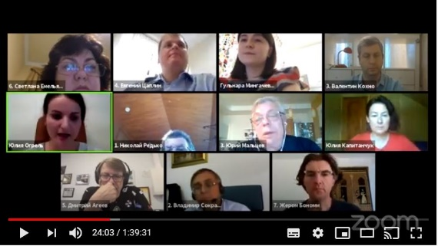
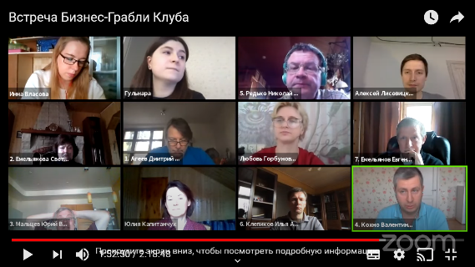
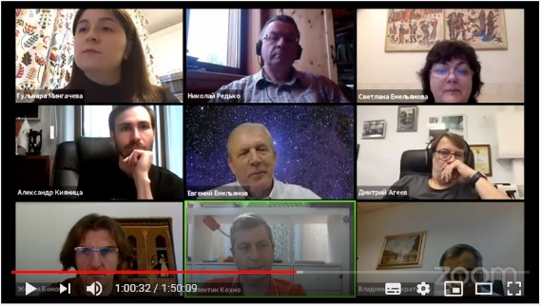
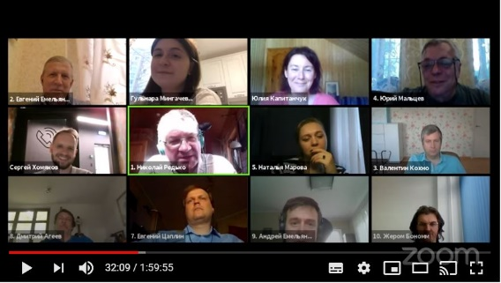
Business Rakes Club
In 2020, the Business Rakes Club held 7 meetings. Only 1 of them was held in person, and then we moved all together online.
8 speakers told us about their projects and got feedback from experts.
At the beginning of the year, we published a new book about Business Rakes Club meetings and now we are preparing to publish the next one.
In December we had our 30th Club meeting and celebrated our 5th anniversary!
We are looking forward to seeing everyone at Club meetings in 2021!

Slide 9
Publications
Although the issue of the coronavirus and falling markets has firmly taken over the headlines, STEP Consulting has continued to write articles for publications.
Fifteen of our articles were published in periodicals like E-xecutive.ru, Retail.ru, Snob and Klerk.
We gave 2 interviews for the Territory PRO portal.
In response to requests from journalists we prepared a number of expert commentaries.
We continued to post STEP blogs on the website.
In 2020 most of our content was published in online media.

Slide 10
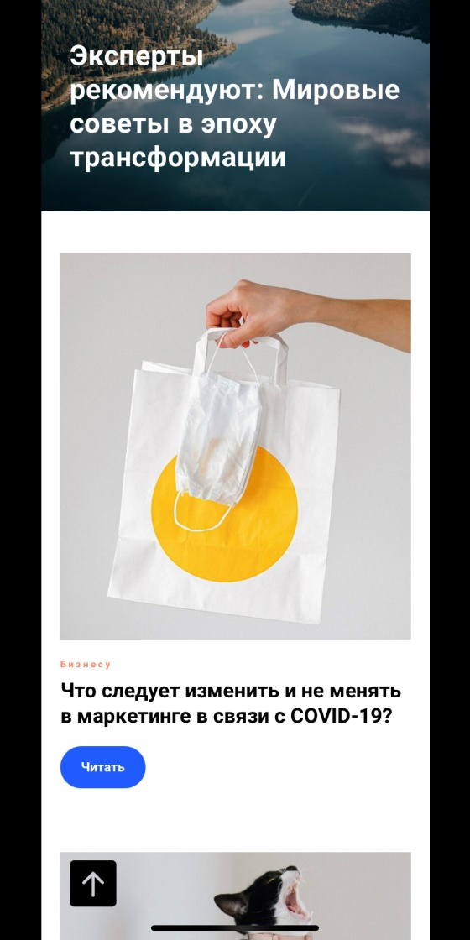
Business Life
We published all six issues of our newsletter. We published them online and printed copies to present to everyone who comes to our office.
For obvious reasons, our online readership has increased – it comes to 3,000 people now.
The April issue of our newsletter was the most read in 2020.
Our readers like not only the fresh issues (the first most visited page), but also the "World Tips" column that we publish on our publication's website.
We have begun preparations to celebrate the 20 th anniversary of the edition. Congratulations are welcome!

Slide 11
TRANSFORMATION TIMES: ONGOING CHRONICLES
«We see the life is going on»
At the end of March, STEP launched a new project: the online publication TRANSFORMATION TIMES: ONGOING CHRONICLES. New issues are published more frequently than our newsletter - once every 2 weeks.
Here we spoke about things that are going on in Russian business, in the world, and shared global advice.
We prepared and sent out 20 issues.
Our May issue turned out to be the most read.
Throughout the year, we received positive feedback on our newsletter. It inspired many people not to give up and go on!
«Everyone is working, so should we»
«Gives you strength»

Slide 12
Coronavirus impact on business
In June 2020, we ran our own small online survey, "How Has the Coronavirus Affected Your Business?"
Number of respondents: 76 (41 of whom were business representatives and 35 were business consultants).
The study showed that the coronavirus epidemic and the self-isolation mode did not go unnoticed by businesses.
According to the results of our survey, both groups of respondents have similar view of what is happening. The world will no longer be the same; we will have to get used to the new reality. Most respondents believe that within 6 months to 1 year the situation in their industries should recover.
For some companies, on the contrary, the pandemic has opened new opportunities. Their financial performance improved, and some even needed to hire new employees.
As expected, many believe that remote working will become commonplace in the future.

Slide 13
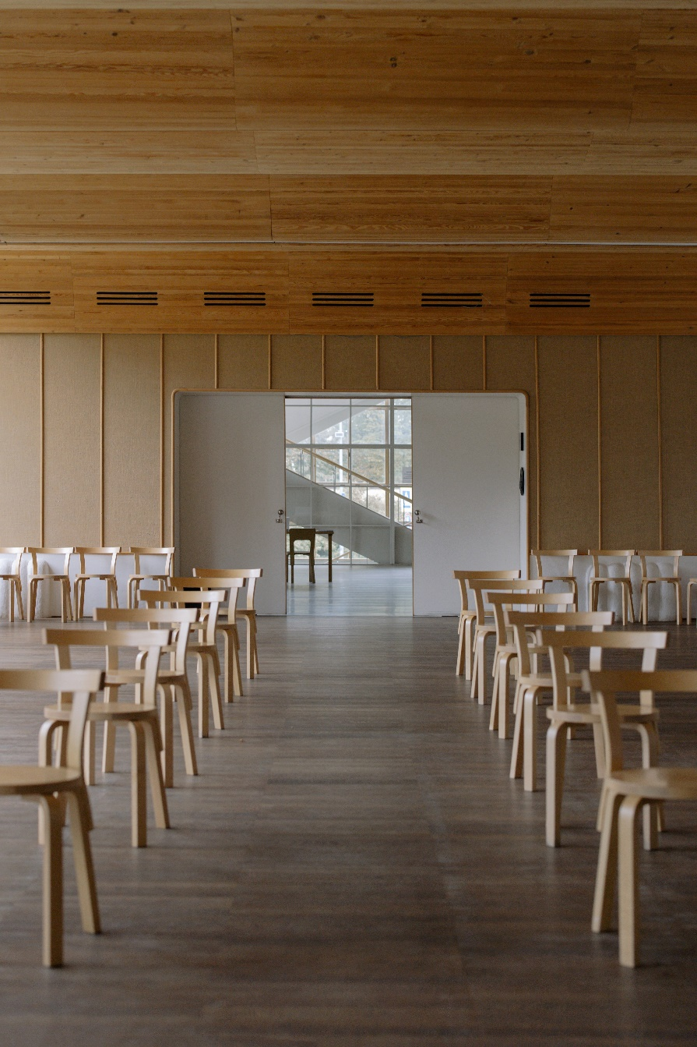
Networking
Step Consulting continued to be active in non-profit activities both in Russia and abroad in 2020:
We are members of Russian and foreign professional communities. Last year we continued to take part in the work of ASCONCO (Association of Consulting Companies) and IMCN (Independent Management Consultancies Network).
STEP confirmed its membership in the Moscow Chamber of Commerce and Industry until 2022.
We have regularly engaged our partners to solve various tasks in the frames of our projects, we are grateful to them for their joint work!

Slide 14
Social Responsibility
In March 2020, STEP Consulting employees joined the social initiative of the RE:BOOKS Official program. The program collects books read by residents of megacities and prolongs their life - some of the books are used to support rural libraries in the Russian North.
STEP Consulting has joined the global social initiative and has opened access to all the archives of its own publication "Life of Business" and to the electronic versions of the Library of Business Owners. The resources remain open and free.

Slide 15
STEP Team
This was our fifth crisis, and we already had the technology worked out!
During the lockdown period, some payments from clients stopped. The employees understood the complexity of the current situation.
We had to cut the income of all employees of the company, including management. The same was done with other expenses. As soon as the opportunity arose, they began to return wages to their previous level.
None of the employees were fired.

Slide 16
STEP Team
Thanks to our IT support, everyone easily switched to a remote work format. Many employees were initially ready for it, because in the last 2 years we already partially worked remotely.
We held meetings and project meetings in the online format. And even a New Year's corporate party held in a hybrid format.
We have also noticed from our employees and clients that some people like working remotely, while others want to get into the office as soon as possible.
Working online, you can get more done, but the quality level of online meetings is not what it used to be in person.

Slide 17
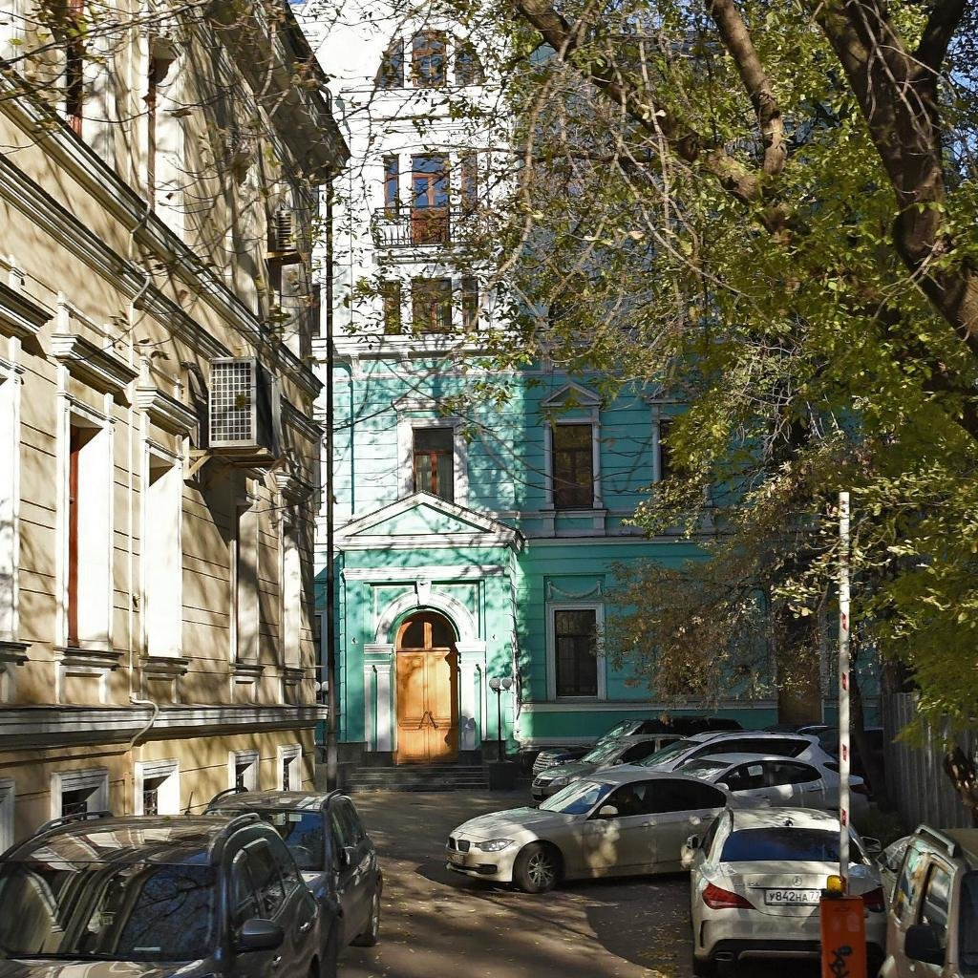
Relocation?!
STEP had a change of "home" in 2020!
Our previous landlord hadn't gone along with us - that was the situation many of our clients had. It was our position to behave ethically towards him, but firmly. The agreement was impossible, so we moved out.
We stayed in the same area, as both clients and employees are more accustomed there.
We are now happy to see everyone at our new address: Spiridonovka St., 20, bld. 2.

Slide 18
THANKS TO EVERYONE WHO WAS WITH US IN 2020

Slide 19
THANK YOU FOR YOUR ATTENTION!
E-mail: step@stepconsulting.ru
Тel.: 8 (495) 258-25-02
Address: 121069, Moscow, Spiridonovka str., 20, bld. 2
www.stepconsulting.ru

